Slide 1
Data Mining for Item Recommendation in MOBA Games
Name: Yuchen Jiang

Slide 2
Motivation
This paper is for researching MOBA games. I played DOTA2 and LOL for many years. And I know there is some prediction systems for the win rate of each team in DOTA2 competition. In this paper, I found that authors want to build a recommendation system for items in MOBA games. I believe it is very interesting. For many beginners and normal players, they need a system like what this paper makes to enjoy games better. As for me, I think I will increase my win rate if someone can recommend items for me.

Slide 3
Introduction
Nowadays, e-sport is very popular. And there are some champion recommendation systems. However item recommendation system is still a blank area. Authors want to use LOL as a example to make some things in this new area.

Slide 4
Main technical contribution
It is special that the dataset used in this study is provided by, consisting of 184,070 ranked matches from the regions of Europe and North America. That is a huge dataset. And normally researches prefer to use information from high-level players. As a low-level player, I know that information from a part of low-level players is worthy of study. That is one point that attracts me.

Slide 5
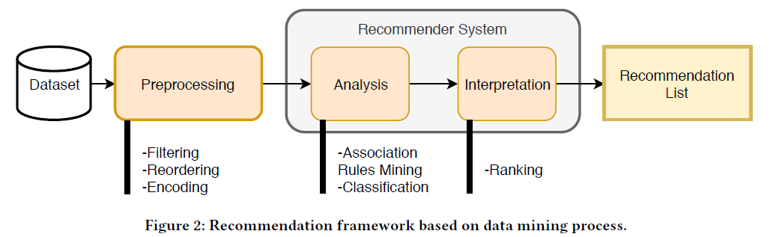
Main technical contribution

Slide 6
Main technical contribution
Figure 2 shows the proposed framework, which is based on classical data mining methodology. They use a slightly different association rules mining approach. They filtered the dataset for each champion of the game for rules mining (including both the enemies confronted and the items used as a transaction). This method can separate each champion and the item purchasing strategy of each champion. That is a good way to make dataset clearly.

Slide 7
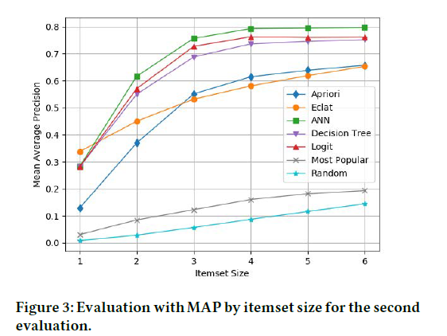
Interesting experimental result

Slide 8
Interesting experimental result
In this experiment, authors divide the dataset of testing into six groups. Figure 3 shows the results. And they also add Random and champion-based Most Popular recommendation because there is not a previous baseline.
It is interesting that you can find the most popular recommendation system achieved only 20% in spite of being a champion-based version.
This result may suggest that items used during a match are dependent on the current situation.

Slide 9
Interesting experimental result
As a MOBA player, I know the choice of items in a match depends on many reasons, not just depends on the choice of champion. This result is suitable for the real situation. Now, there is a question whether most popular recommendation method is better than ANN(Artificial Neural Network) in a real match or not. I prefer to believe most popular recommendation method has reliability in a real match.

Slide 10
Limitation
First, this item recommendation system is not real-time. It is just depends on enemy team(five champion). I think it just provide a reference for low-level players and it is useless for high-level players.
Second, this dataset should be larger. In this paper, dataset just include matches from the regions of Europe and North America. In China, there are lots of players. And in different areas, players may prefer different items to deal with a same situation.
Last but not least, in next experiment, they should consider more factors to improve this item recommendation system, for example, experience of champions, gold of champions or even tactics.

Slide 11
Further work
There is a long way to make this system be a great service for all players in MOBA games. They may continue with the context approach, but use additional information such as the allied team, characteristics of the items, and the role of the characters. Future work may focus on assert which technique could run in real-time without losing accuracy.

